Slide 1
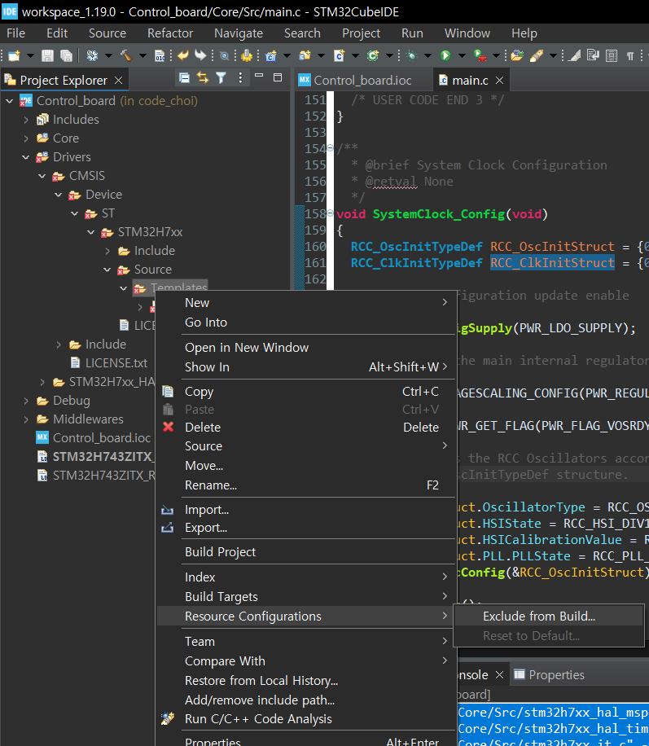
Control Board
- STM32H743ZIT6
1. RTOS V2 선택
2. Sys 타이머 : 17사용, 우선순위 0
3. FreeRTOS > Advanced Settings > USE_NEWLIB_REENTRANT
1. system_stm32h7xx.c 중복 제외

Slide 2
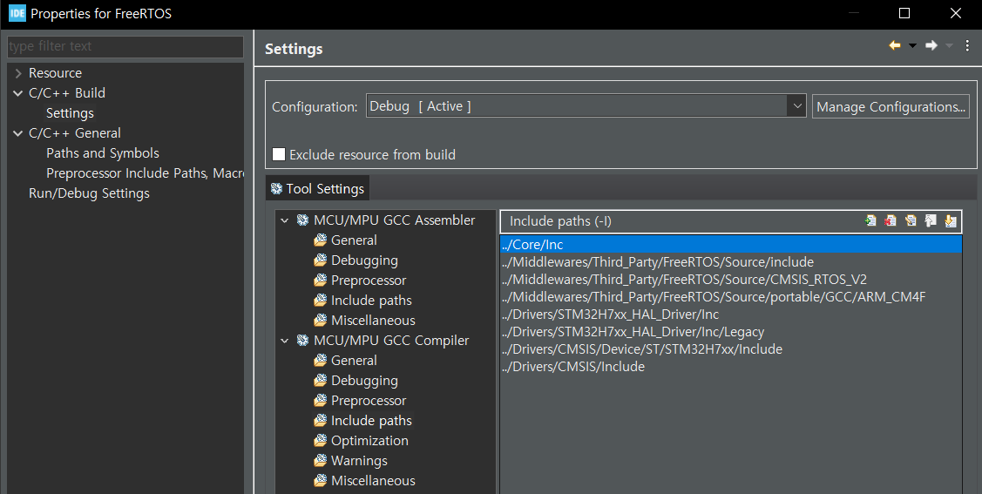
-. Middlewares/Third_Party/FreeRTOS 폴더 우클릭
-. Properties>C/C++ Build>Settings이동
-. MCU GCC Compiler>Include Paths에 아래 경로 추가
../Middlewares/Third_Party/FreeRTOS/Source/include
../Middlewares/Third_Party/FreeRTOS/Source/CMSIS_RTOS_V2
../Middlewares/Third_Party/FreeRTOS/Source/portable/GCC/ARM_CM4F

Slide 3
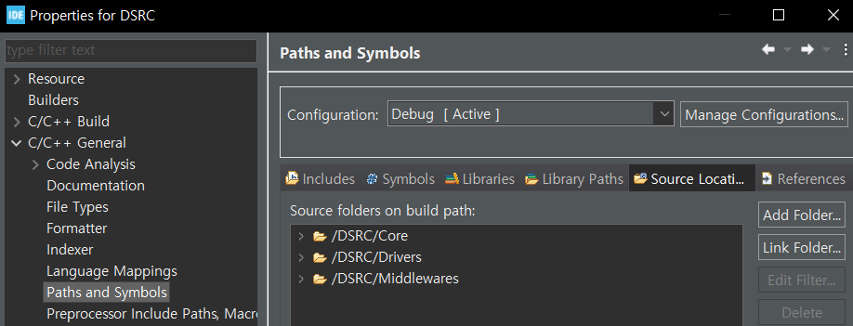
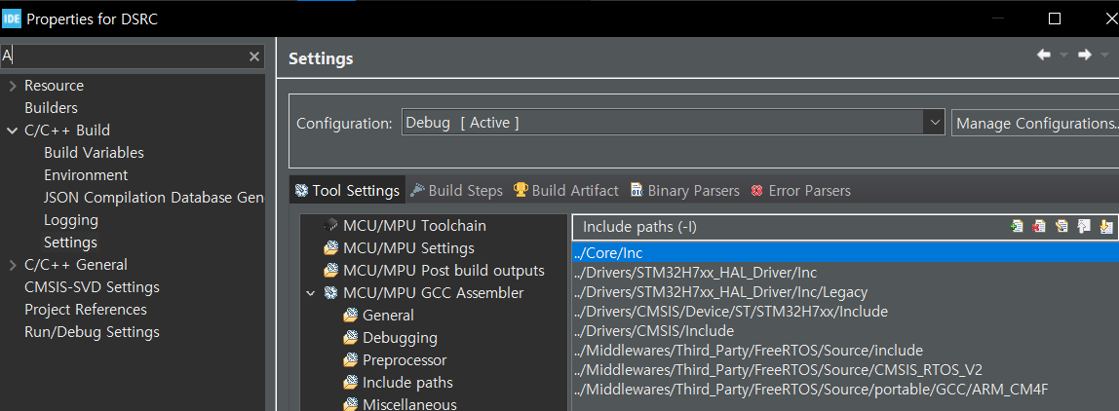
-. 전체 프로젝트 우클릭해서 paths and Symbols로 이동하고 source location에서 Middlewares폴더 추가
-. 전체 프로젝트 우클릭해서 c/c++ Build>settings>include Paths에 하기 사항 추가
../Middlewares/Third_Party/FreeRTOS/Source/include
../Middlewares/Third_Party/FreeRTOS/Source/CMSIS_RTOS_V2
../Middlewares/Third_Party/FreeRTOS/Source/portable/GCC/ARM_CM4F

Slide 4
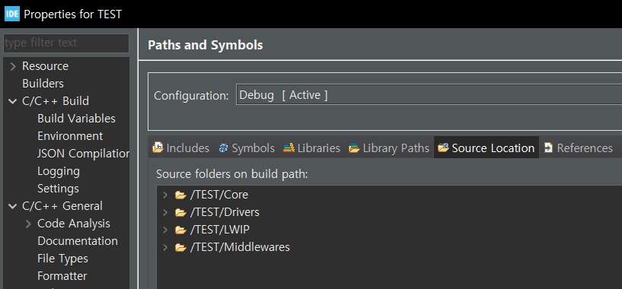
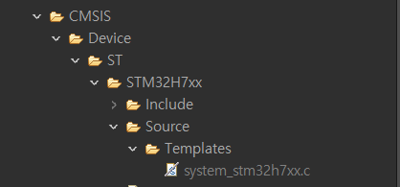
LWIP 포팅도 거의 RTOS하고 유사하다.
폴더 넣기
../LWIP/App
../LWIP/Target
../Middlewares/Third_Party/LwIP/src/include
../Middlewares/Third_Party/LwIP/src/include/netif
../Middlewares/Third_Party/LwIP/system
../Middlewares/Third_Party/LwIP/system/arch
../Drivers/BSP/Components/lan8742
이 파일은 EXCLUDE

